Slide 1


SAP CLOUD APPLICATION PROGRAMMING AND XSA TRAINING IN BPT
Anubhav Oberoy
Day – 2

Slide 2

Agenda – Day 2
Introduction to NodeJS
Basic of JavaScript
Functions in JavaScript
Asynchronous Behavior of JavaScript
Concept of Events in NodeJS
Introduction to Node Package Manager (NPM)
Accessing the global modules
Steps to Initialize a NodeJS Project
Creating a server using NodeJS and Express module
Creating Microservice using NodeJS

Slide 4

What is NodeJS?
Node JS is an open-source, cross platform, JavaScript runtime environment and used to execute JavaScript on Server Side.
Node JS is a framework which allows us to run JS code outside browser. The main benefit is that a development do not need to learn multiple programming languages. If we know JS, we can code both client and server side in same language.
Node JS is also a great web framework for beginners because it works great for data intensive applications like streaming, gaming and real time apps. It leverage the power of JS’s Asynchronous no blocking IO.
Application of Node JS
Build Backend Application Logic
Host a Web Server (express)
Send Emails
DB lookup
Automation
Output to the user
Use its eco-system like PDF, EXCEL, EMAIL…
Install NodeJS in our system form here https://nodejs.org/en/, if you using bas, you do not need to install as BAS already has NodeJS preinstalled.
If we want to achieve something, this something was already achieved by someone, somewhere else in the world, they have already published it as a node module which we can import and reuse. We get ready-to-use code for consumption for speedy development. https://npmjs.com

Slide 5
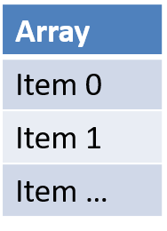
Basic of JavaScript
JS is case-sensitive (80% developers does case-sensitive errors)
Every statement in JS ends with semi-column
JS Naming convention is camel case, the first letter of any word is small, next consecutive word’s first letter is caps.
Ex:-
iloveindia ➔ iLoveIndia
wearelearningJS ➔ weAreLearningJs
An array is a collection of values, each value is an item of an array. The index of first item always starts with zero (0)
Syntax for Array
var aItems = [item0, item1,….]
Ex:
var myArr = [1, 2, 3, 4, 5];
var myArr2 = [‘a’, ‘b’, ‘c’];
Objects are like structures to contain multiple fields of different kinds.
Syntax for object
var oObjName = { “prop”: value,
“prop”: value,
“prop”: value }
Example of an Object
{
"empStructure": {
"empNo": 100001,
"empName": “Anubhav",
"salary": 5000,
"currency": “USD"
}
}
We can verify the structure of our JSON on : https://jsonlint.com/

Slide 6

Exercise
In this exercise we will create a new JavaScript and we will see some basic concepts of java script related to variables in JS and along with that will see how to work with Arrays and Objects in JavaScript.
Part 1: Basics of JavaScript
sample.js
Part 2: Working with Arrays in JS
sample.js
Part 3: Working with Objects and Array of Objects in JS
sample.js

Slide 7
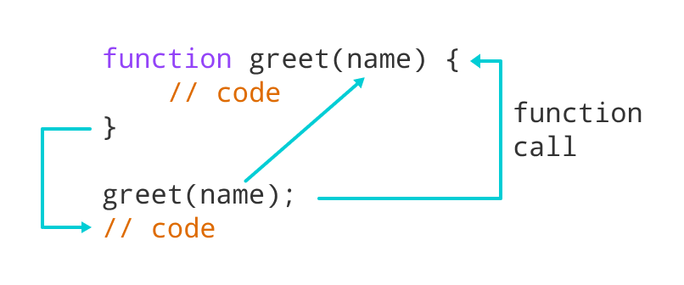
Functions in JavaScript
Functions in JavaScript
A JavaScript function is a block of code designed to perform a particular task.
A JavaScript function is executed when "something" invokes it (calls it).
A JavaScript function is defined with the function keyword, followed by a name, followed by parentheses ().
The code to be executed, by the function, is placed inside curly brackets: {}
Function parameters are listed inside the parentheses () in the function definition.
Function arguments are the values received by the function when it is invoked.
Inside the function, the arguments (the parameters) behave as local variables.
Types of functions
Functions are of 2 types →
1. Anonymous function
function(params) {
//code
}
2. Named Function
function functionName(params) {
//code
}

Slide 8

Exercise
In this exercise we will see how we create functions in JavaScript and what are the different syntaxes of defining the functions. Along with that we will see the concept of reusable modules in NodeJS and with that we will see the use of Global Variables.
Part 1: Named Function Basics
FunctionBasic.js
Part 2: Concept of Reusable module in NodeJS
FunctionBaisc.js
reuse.js
Part 3: New Syntax of defining function and Global variable
FunctionBasic.js
JS is asynchronous Non Blocking Programming language. Also is an event driven programming language.
Server
Java
ABAP
Client
Java Script
Node JS
Java Script

Slide 9
Asynchronous behavior of JavaScript
UI
Module
w
async
Util (in-built)
Callbacks
Promise

Slide 10

Exercise
In this exercise we will see the asynchronous behavior of JavaScript. We will see the use of Callback function and Promise in JavaScript. Along with that we will see the JavaScript’s reusable module ‘util’ to promisify a function.
Part 1: Concept of Callback Function
AsyncFunciton.js
Part 2: Concept of Promise in JavaScript
AsyncFunction.js
Part 3: Promise using a reusable module.
AsyncFunction.js

Slide 11

Concept of Events in NodeJS - Exercise
Node.js has an event-driven architecture which can perform asynchronous tasks. Node.js has ‘events’ module which emits named events that can cause corresponding functions or callbacks to be called.
In this exercise we see how to use events in NodeJS. We will see Simple events as well as How to use events in Real life examples.
Part 1: Simple Event Example
EventConcept.js
Part 2: Event Concept using Real Life example
EventConcept.js

Slide 12

NPM – Node Package Manager
Node Package Manager (NPM) is a command line tool that installs, updates or uninstalls Node.js packages in your application. It is also an online repository for open-source Node.js packages. The node community around the world creates useful modules and publishes them as packages in this repository.
npm is the world's largest Software Registry.
The registry contains over 800,000 code packages.
Open-source developers use npm to share software.
Many organizations also use npm to manage private development.
npm is installed with Node.js
NPM is included with Node.js installation. After you install Node.js, verify NPM installation by writing the following command in terminal or command prompt ‘npm –v’
https://www.npmjs.com/

Slide 13
Access Global Node JS Modules
We can add the Global modules present on the NPM repository in our project.
To include the modules in our project we can use the following npm command:
‘npm install <moduleName>’
This command will Keep the module within the project, if we want to use that module in another project then we have to install it again in that project also.
Now if we want add a module which can be shared within all the projects, then we have to install that module globally in our system. To do that we have to use the following npm command:
‘npm install –g <moduleName>’
If there is a utility, command line tools we install them globally
package.json
project
project
project
local
global
global
module
Package.json file
Information about our project name, author, version
All the dependencies required by this node project
When we deploy our project in another system/machine we can use npm install command
module

Slide 14
Steps to create a Fresh NodeJS Project
Run a command called npm init – Create a new Nodejs project
Answer some simple questions like project name, starring file, author, version, description, …
As we mentioned that our starting file will be index.js. So now we have to create a new file named index.js.
We can just add some code to this file with all the modules
Then we run npm install moduleName --save OR npm install moduleName --save-dev to add a module to our project.
To run the project, we can use the ‘node .’ command in the terminal.
Exercise: In this exercise we will create our first NodeJS project following the above steps.
index.js
Phase 2 – Create a webserver and microservice using ‘express’
Install express module and add that as dependency also to our project npm install express –save
You can check package.json and you will find dependencies
Use express module to create web server (refer index.js file)

Slide 15
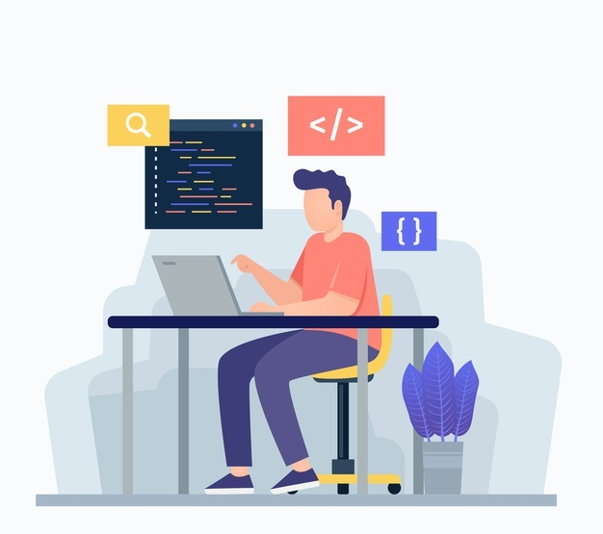
Exercise
In this exercise we will create a simple microservice using the NodeJS and express server module.
Part 1: Creating a Simple NodeJS app with express server
index.js
Part 2: Creating a Microservice which return a JSON data
index.js

Slide 16

End of Day 2

Slide 17

Questions

Slide 18

Anubhav Oberoy

Slide 19


We’re committed to empower you to be
Most Desirable Resource
through powerful training solutions.
We build the workforce of the future.
250+
Corporate Clients
30,000+
Learners Trained
25000+
Learners Placed
FREE WEBINARS
Sign up for free webinars with industry experts every fortnight!
Enroll Now!
Contact us today!
https://anubhavtrainings.com/

Slide 20




More from AnubhavTrainings.com

Slide 21
Title
Content

